Slide 1
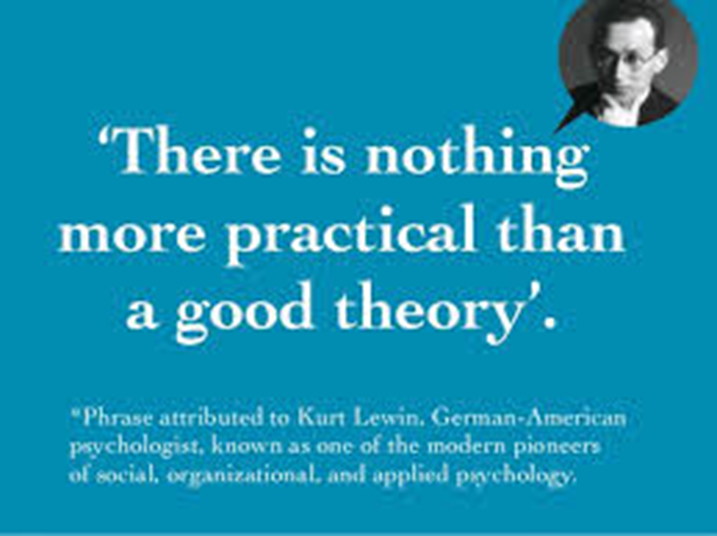
The Theoretical approaches in SIC

Slide 2
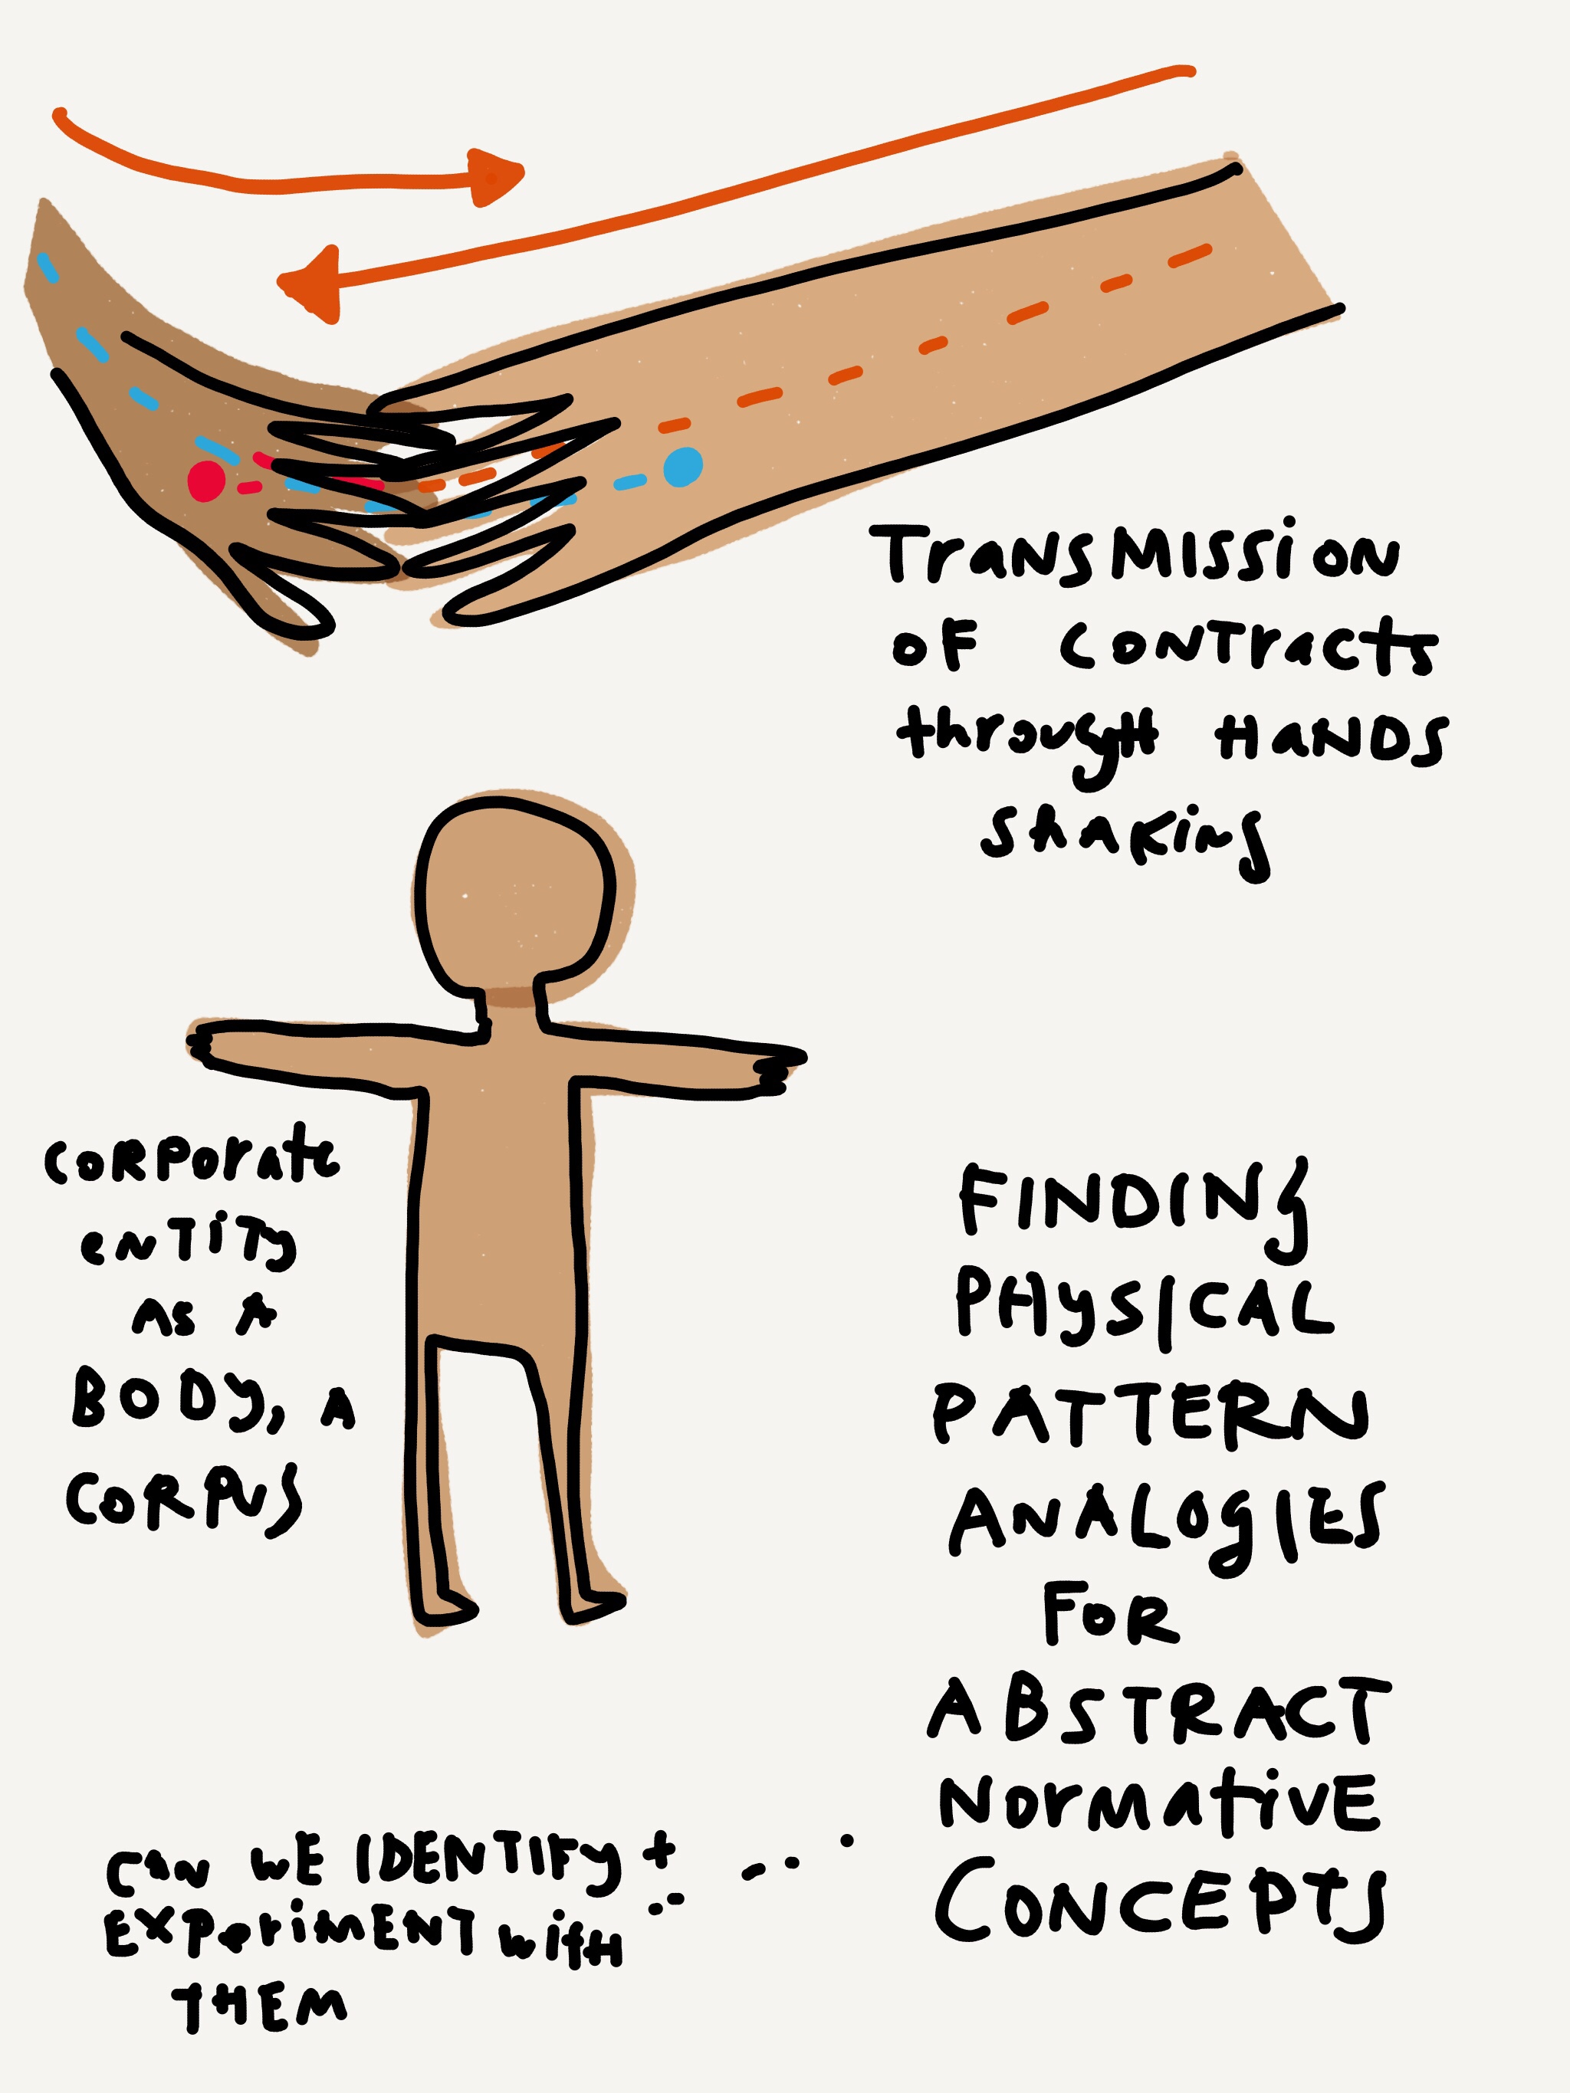
1- Introduction
The theoretical approach is a necessity for any thesis.
Quality assessment is based on a paradigm to structure the research work.
The use of theory is essential for any scientific research.

Slide 3
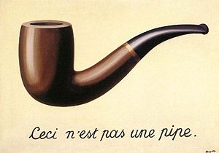
1 – La thèse comme art de se poser des questions, liées à l’obligation de distanciation
The thesis is the art of asking questions and it is related to the obligation of distancing.
Evidence for the researcher is Always facing the common belief. (doxa)
The wise man continues to wonder when the fool already has the answer.
Many authors warn against the illusion of immediate comprehension.

Slide 4
Obligations:
Be wary of preconceptions.
Deconstruct the evidence of subjective knowledge and mosaic culture.
Destroy intuition for the benefit of the built.
Use toward the immediate and seductive reading of the real, methodological, conceptual and theoretical breaking techniques.

Slide 5
Criticism is regular against the pseudo non-cumulative knowledge:
How to learn in societies characterized by fluidity, by the accelerated intensity of solicitations, sensory flows, bits of unlimited knowledge? (Henry Holt, 2002.)
Liquid modernity produces fragmentation, dispersion, disengagement, preventing continuity and provoking psychic insecurity (Zygmunt Bauman, 2000).
The triumph of the transitory, the ephemeral, the discontinuous, in short instability, make the knowledge difficult, even impossible for lack of time (Claudine Haroche, 2008).

Slide 6
The importance of theories:
In a field like Communication, theories are important to understand because they directly impact our daily lives:
They help us organize and understand our communication experiences.
They help us choose what communicative behaviors to study.
They help us broaden our understanding of human communication.
They help us predict and control our communication.
They help us challenge current social and cultural realities and provide new ways of thinking and living.

Slide 7
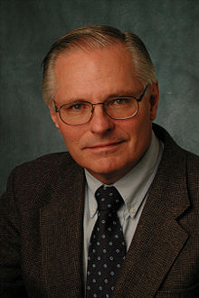
2- The theoretical approaches: Craig identifies seven different traditions of Communication Theory and outlines how each one of them would engage the others in dialogue: (Robert T Craig,1999)
• Rhetorical
• Semiotic
• Phenomenological
• Cybernetic
• Socio-Psychological
• Socio-cultural
• Critical

Slide 8
Approaches of Communication and their theories:
Message production: Constructivist Theory, Action Assembly Theory..
Message processing: Elaboration Likelihood Model, Inoculation theory..
Discourse and interaction: Speech Acts Theory, Coordinated Management of Meaning..
Developing relationships: Uncertainty Reduction Theory, Social Penetration Theory, Predicted Outcome Value Theory..
Ongoing relationships: Relational Systems Theory, Relational Dialectics..
Organizational: Structuration Theory, Unobtrusive and Concertive Control Theory..
Small group: Functional Theory, Symbolic Convergence Theory…
Media processing and effects: Social Cognitive Theory, Uses and Gratifications Theory…
Media and Society: Agenda Setting, Information deficit model, Spiral of silence, Symbolic Convergence Theory…
Culture: Speech Codes Theory, Face-saving Theory…
Making social worlds: Coordinated Management of Meaning, Symbolic Interactionism…
Science Communication: Gateway Belief Model…

Slide 9
List of communication theories:
Adaptive Structuration Theory
Agenda-Setting Theory
Argumentation Theory
Attribution Theory
Classical Rhetoric Theory
Cognitive Dissonance theory
Computer Mediated Communication
Contextual Design Theory
Coordinated Management of Meaning
Cultivation Theory
Dependency Theory
Framing Theory

Slide 10
Diffusion of Innovations Theory
Domestication Theory
Elaboration Likelihood Model
Expectancy Value Theory
Gatekeeping Theory
Health Belief Model
Hypodermic Needle Theory
Information Theory
Knowledge Gap Theory
Language Expectancy Theory
Media Richness Theory
Medium Theory
Mental Models
Minimalism Theory
Model of Text Comprehension

Slide 11
Modernization Theory
Network Theory and Analysis
Priming Theory
Protection Motivation Theory
Transactional Model of Stress and Coping
Two Step Flow Theory
Uncertainty Reduction Theory
Uses and Gratifications Approach
Psycho-Linguistic Theory
Social Cues Approach
Semiotic Theories
Social Cognitive Theory
Social Identity Model of Social Presence Theory
Social Support Theory
Speech Act Theory
Spiral of Silence Theory
System Theory
Theory of Planned Behavior/ Reasoned Action
……….

Slide 12
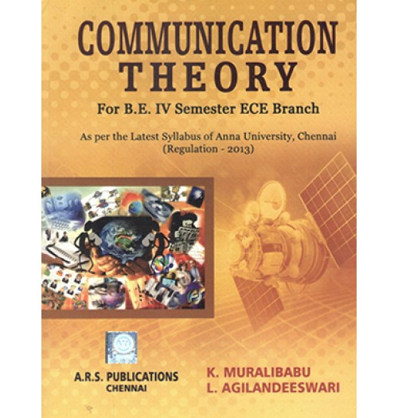
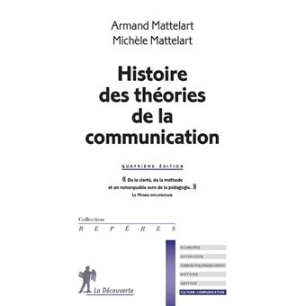
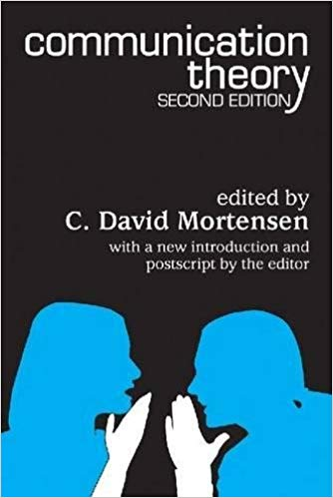
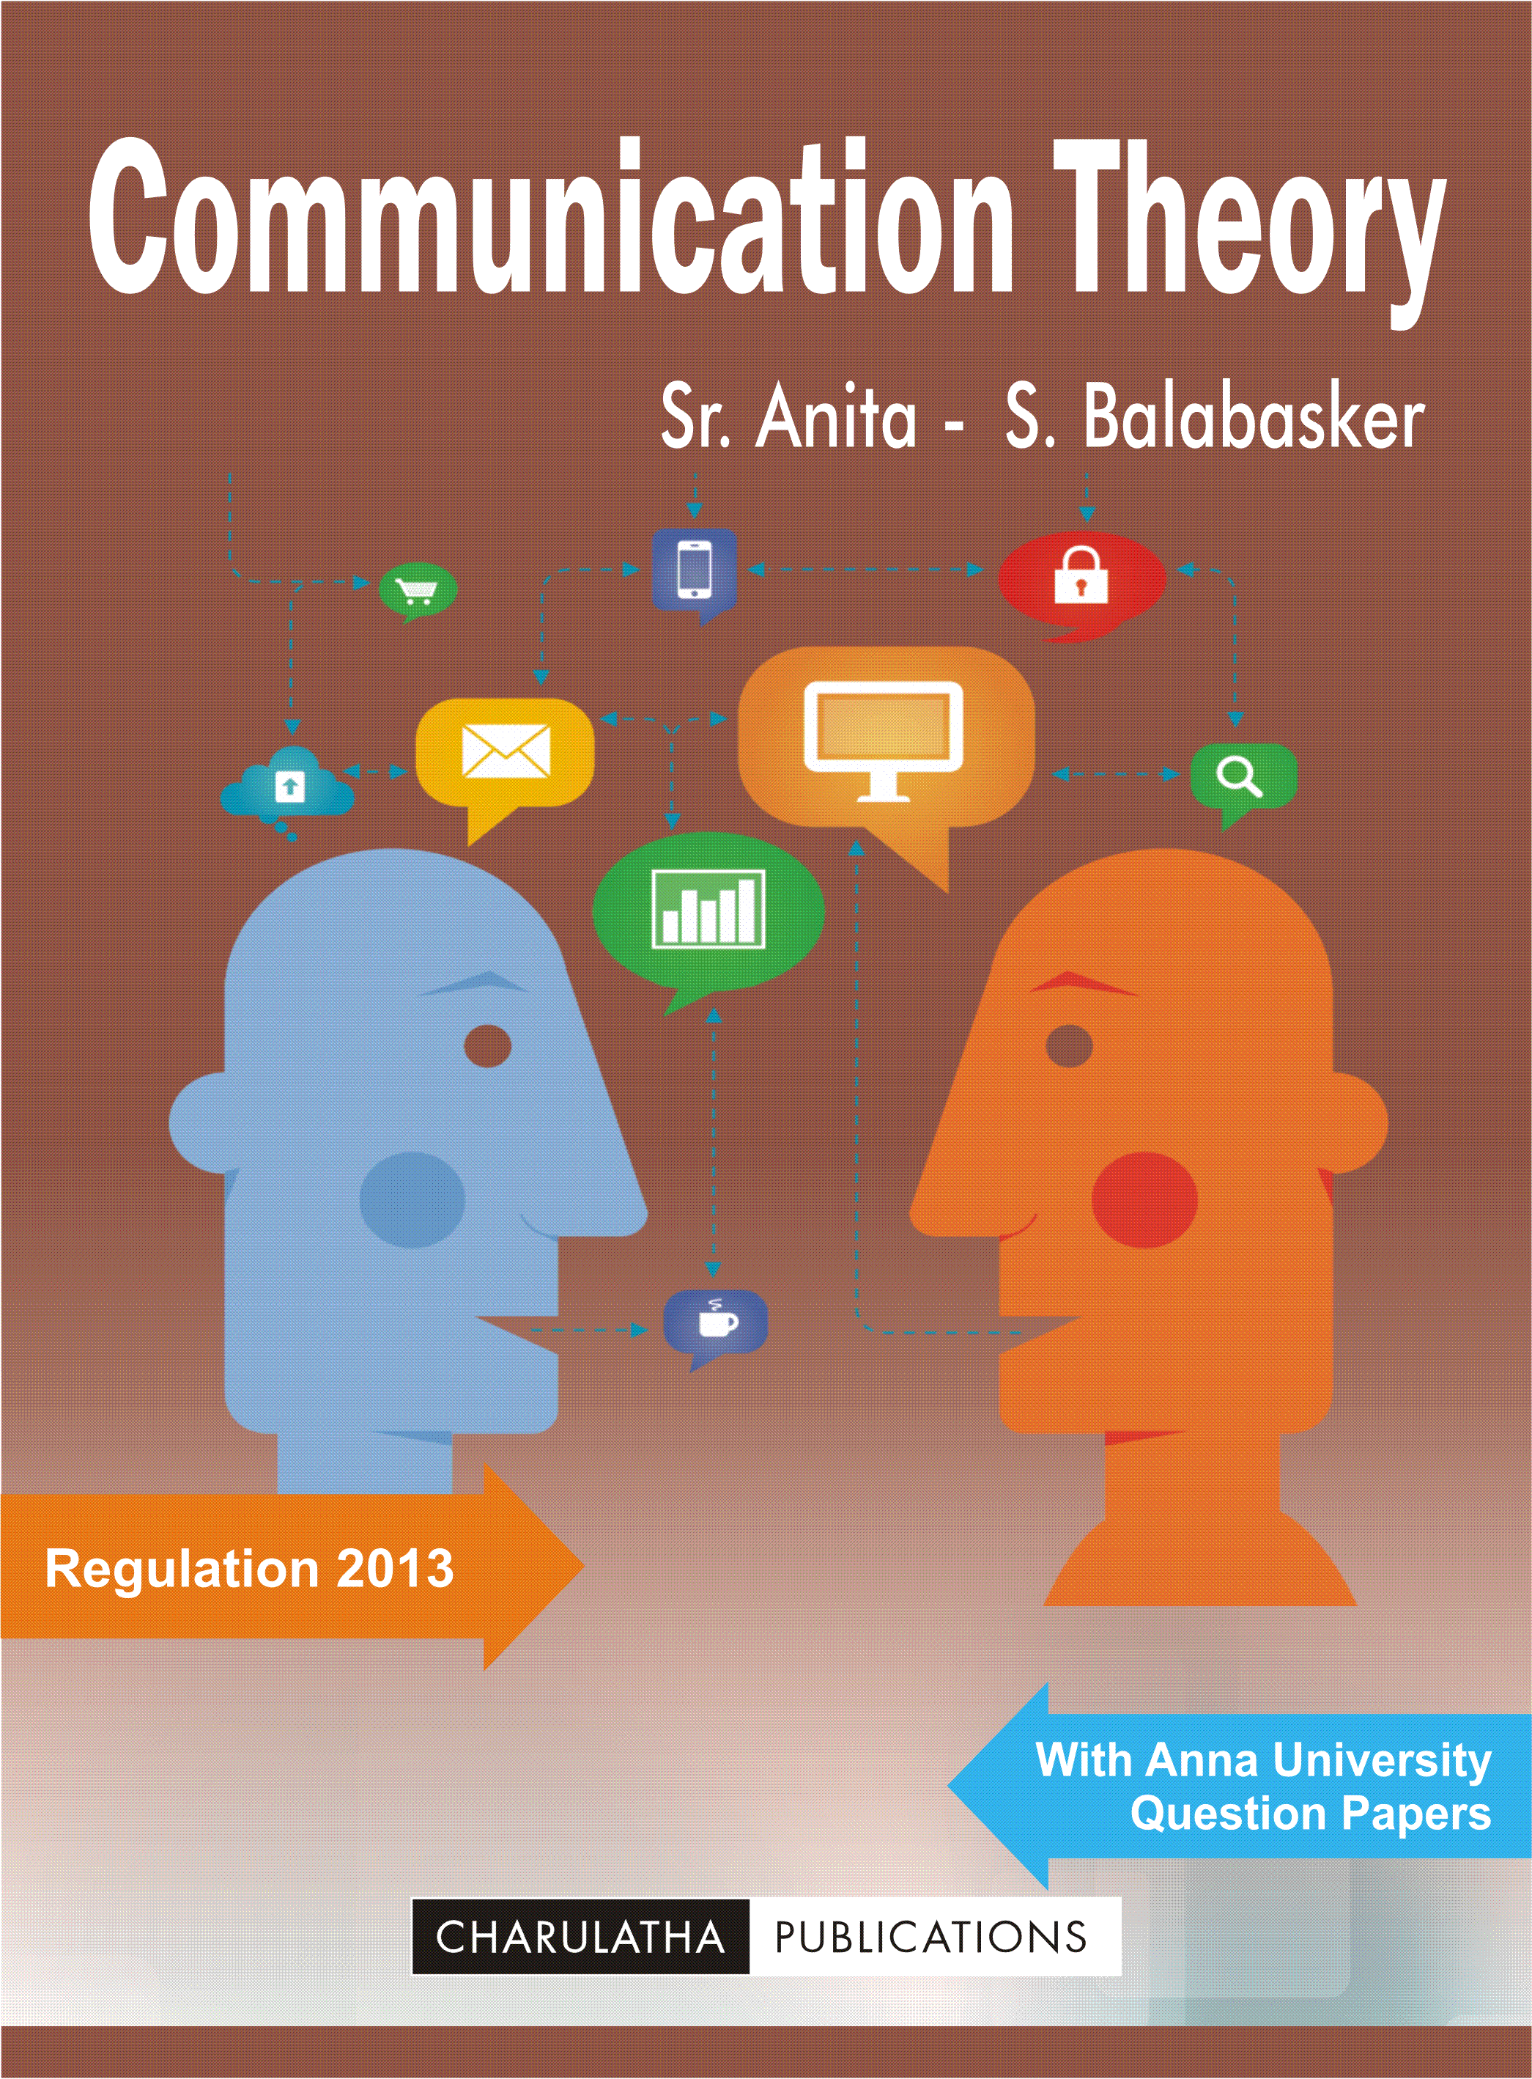
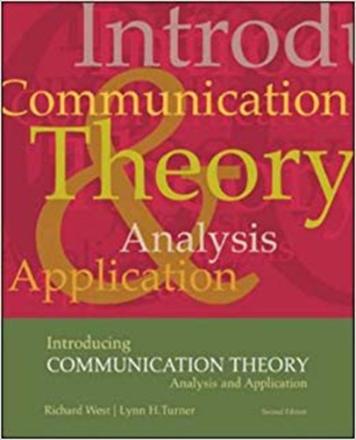
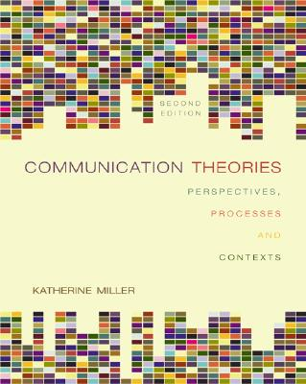
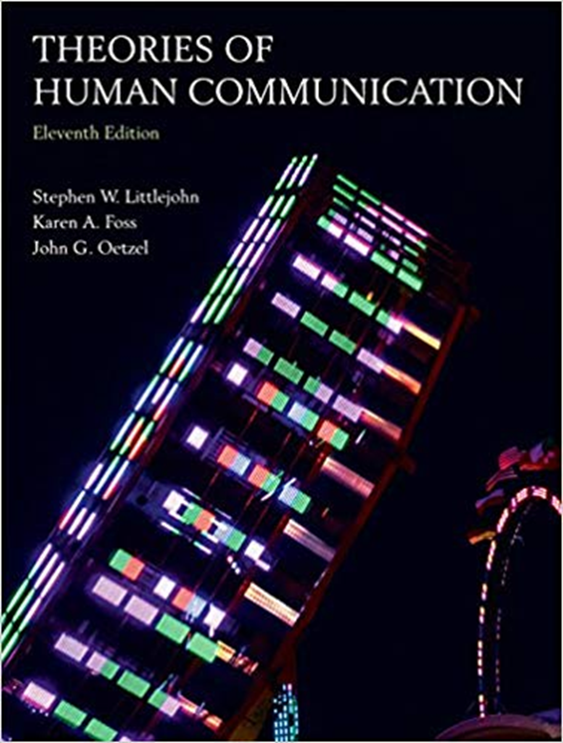

Slide 13
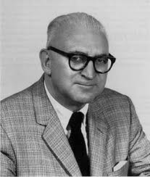
3-The evolution of theories:
An example: - Uses and Gratifications Theory:
Stage 1
Beginning in the 1940s, researchers began seeing patterns under the perspective of the uses and gratifications theory in radio listeners. Early research was concerned with topics such as children's use of comics... An interest in more psychological interpretations emerged during this time period.
In 1948, Lasswell introduced a four-functional interpretation of the media on a macro-sociological level. Media served the functions of surveillance, correlation, entertainment and cultural transmission for both society and individuals.

Slide 14
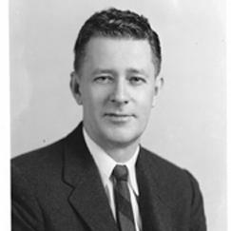
According to West and Turner, UGT was an extension of Needs and Motivation Theory, as outlined by Abraham Maslow in 1954, which argues that people actively looked to satisfy their needs based on a hierarchy. These needs are organized as Maslow's Hierarchy of Needs in the form of a pyramid .
In 1954 Wilbur Schramm developed the fraction of selection, a formula for determining which form of mass media an individual would select. The formula helped to decide the amount of gratification an individual would expect to gain from the medium over how much effort they had to make to achieve gratification.

Slide 15
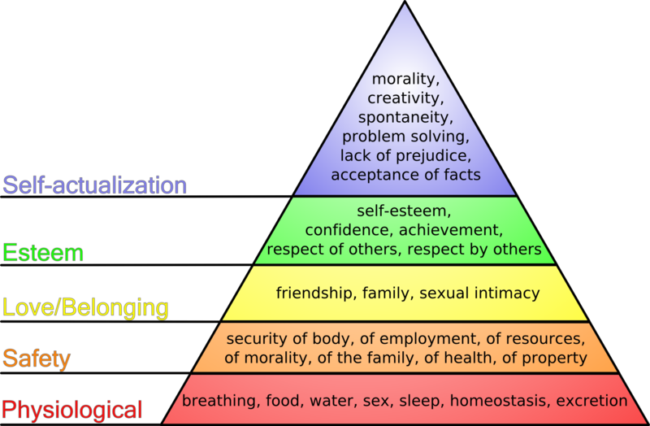

Slide 16
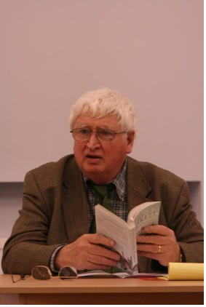
Stage 2
In 1972 Denis McQuail, Jay Blumler and Joseph Brown suggested that the uses of different types of media could be grouped into 4 categories: diversion, personal relationships, personal identity and surveillance.
AIn 1973-74 McQuail, Blumler and Brown were joined by Elihu Katz, Michael Gurevitch and Hadassah Haas, in their media exploration. The collaborative research began to indicate how people saw the mass media.

Slide 17
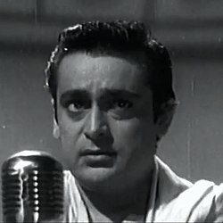
Stage 3
The most recent interest surrounding Uses and Gratifications Theory is the link between the reason why media is used and the achieved gratification.
In the 1980s, Rehman (1983) applied UGT to study the relationship between the movie audience expectations and satisfaction derived from going to the movies.

Slide 18
5-The Social Media Theories and Models :
Towards the end of the 1990s, the Web, and its architects, forged the tools that would spark a renaissance of influence and empowerment.
The Social Revolution is the catalyst for the democratization of content and exchange of information.
But we're still experimenting and wrestling with the true impact of this change and how exactly these new models, on every side of the equation, will ultimately settle.

Slide 21
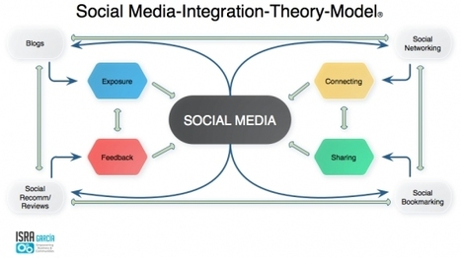
Sam Wee 2018

Slide 22
Stage 4 Modern applications of uses and gratifications research: Mobile phone usage:
In general, people use mobile phones for the following uses and gratifications:
Affection/sociability
Entertainment
Instrumentality
Psychological reassurance
Fashion/status
Mobility
Immediate access

Slide 23
Internet usage:
The Internet provides a new and deep field for exploring UGT. It was found to have three main categories of gratifications:
Content: Uses for the Internet include the need for researching or finding specific information or material, which are gratified with content.
Process: Users gain gratification from the experience of purposeful navigating or random browsing of the Internet in its functional process.
Social: Uses encompass a wide range of forming and deepening social ties.

Slide 24
Social media usage:
Users have motivations of the following overall:
Social and affection
Need to vent negative feelings
Recognition
Entertainment
Cognitive needs
Forums were found to be the main media for venting negative feelings, potentially due to the fact that comparatively, forums are more of a one-way street.

Slide 25
Web 2.0 has modified the communication ecosystem and this calls into question certain points of the Lazarsfeld model:
The individual is both a producer and a receiver of media content, which complicates the already controversial issue of influence.
This is what new researchers in media studies call the "complex receiver".
Blogs, wikis, videos, social networks are platforms that allow anyone to share information, sometimes reaching even larger audiences than traditional media.

Slide 26
The information is thus increasingly transmitted by influential but non-expert personalities who address directly to their followers, mainly via YouTube and Twitter.
This is how brands, rather than going through traditional networks to advertise, are willing to pay millions for a simple photo on the Instagram account of an influential person on the web.

Slide 27
The media no longer have a monopoly on information. Before the web, it was they who were directing the national debate.
From now on, the debates are initiated on the networks and it is sometimes the traditional media which adapts to these subjects.

Slide 28
Due to the rapid adoption of Social Media Marketing as a major communication integration medium, it's necessary to consider how the social interaction has affected the communication process.

Slide 29
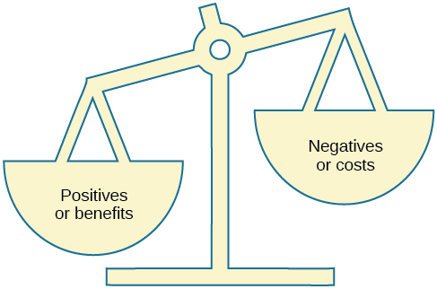
A : Social Exchange Theory (Thibaut & Kelley, 1952):
Social Exchange Theory, or SET, says that you choose the relationships you invest in because they’re beneficial to you in some way. There is a constant reconsideration of costs and rewards, which sounds a little harsh when it comes to humans, but it’s what we do all the time.

Slide 30
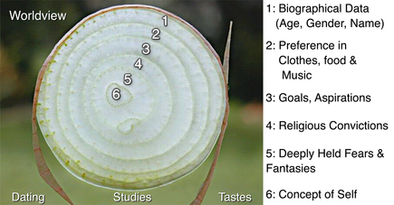
B: Social Penetration Theory (Altman & Taylor, 1973) :
Social Penetration Theory provides a name for the super common phenomenon called “getting to know someone.” This theory posits that interpersonal relationships move from a very shallow, surface level to deeper, more intimate levels over time. Moving between the levels and getting to know someone better happens with mutual self-disclosure, or sharing inner feelings, and vulnerability, which is also, incidentally, sharing inner feelings.

Slide 31
C: Expectancy Violation Theory (Burgoon, 1978):
Expectancy Violation Theory, or EVT, tries to explain human reaction to unexpected behavior. The unexpected behavior can be either positive, like saying ‘I love you’ for the first time or negative, like criticizing your relational partner.

Slide 32
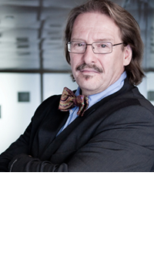
6- New horizons:
Community Design:
Researchers are remodeling the Theory of communication and the Theory of the mobilization of collective knowledge.

Slide 33
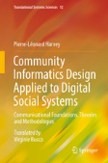
A project of emancipation, a "counter-expertise" that comes out of organizations, positivism and design centered exclusively on technology, to direct researchers towards analysis and social action.
Knowledge is born in action within new digital social systems.
A new sociotechnical approach that multiplies the angles of disciplinary analysis.
A new research strategy in applied communication.

Slide 34
Connectivists claim that the background or the general climate has recently changed: a new generation of researchers, connectivists propose a new way of conceiving knowledge.
Knowledge is a network and learning is a process of exploring this network.

Slide 35
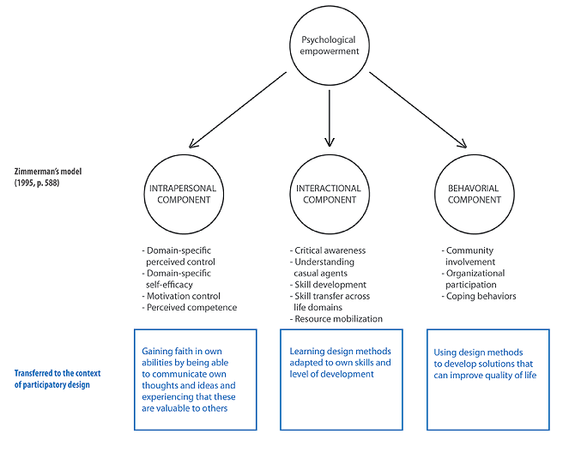

Slide 36
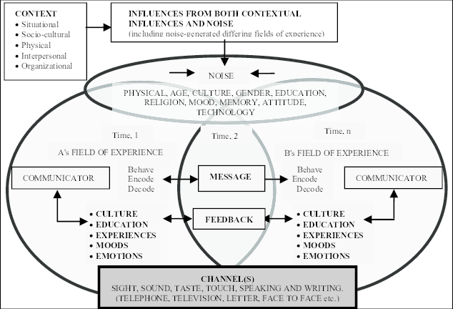
Transmission model.
Interactional model.
Transactional model.

Slide 38
7- Mapping Social Media Research:
We must first understand the current landscape of this still emerging field of social media research.
The Figure below shows a map of the topics frequently mentioned in the 14,500 abstracts of journal articles and conference papers on “social media” or “social networking websites” published after 1999.
Looking at the map, one can see that some of the most researched areas in social media research include: (1) health-related research, (2) studies focusing on the educational use of social media, (3) computational and computer science papers, (4) business, organizational and marketing studies, as well as (5) studies on political and social engagement.

Slide 39
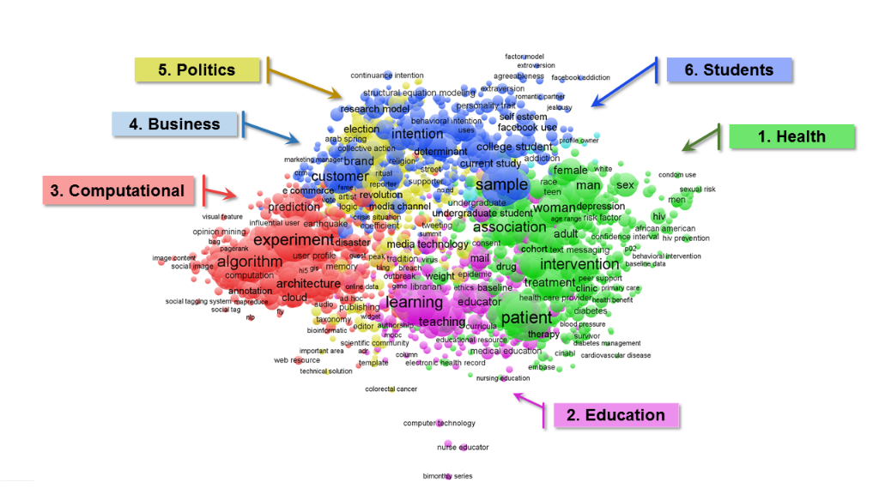
Popular Topics Discussed in Social Media Literature:

Slide 40
By examining the map more closely, it reveals an abundance of studies about college students and their use of Facebook (marked in the map as area #6).
Older adults are now embracing social media in ever increasing numbers; as a research community, we need to start including older demographic into studies of social media use.
Neither journalists nor legal professionals are featured in this high-level view of the research area. As these two professions are increasingly adopting social media, we expect to see more papers published about their social media use and the impact of social media on their work.

Slide 41
Conclusion: The researcher is faced with two risks:
The concept, raised to the rank of a dogma ;
The prenotion, raised to the rank of an evidence.

Slide 42
Looking to the future, to grow and deepen this field of research, media researchers need to ground their work into a more solid theoretical foundation.
Without this foundation we risk remaining a field awash in niche empirical studies and being driven by ever-changing computational algorithms, new interfaces and functions of social media websites, changing user needs and advances in big data analytics.
Perhaps due to the complexity and multidisciplinary of the field, there is currently no single theory that can explain the nuanced nature of social media uses, users and interfaces.

Slide 43
Thank you for listening

